Slide 1
Help Wanted Online A real-time measure of job postings
May 2022
Office of Research Connecticut Department of Labor
Connecticut Department of Labor – Research Office 200 Folly Brook Blvd. Wethersfield, CT 06109
Help Wanted Online

Slide 2
What is HWOL?
The Conference Board Help Wanted Online® Data Series (HWOL) measures the number of new, first-time Online job postings and jobs reposted from the previous month for over 50,000 Internet job boards, corporate boards and smaller job sites that serve niche markets and smaller geographic areas.
Connecticut Department of Labor – Research Office 200 Folly Brook Blvd. Wethersfield, CT 06109
Help Wanted Online

Slide 3
Upcoming Release Dates
Monthly Report: Friday, June 10th, 2022 Weekly New Ads Report: Updated every Friday
Connecticut Department of Labor – Research Office 200 Folly Brook Blvd. Wethersfield, CT 06109
Help Wanted Online

Slide 4
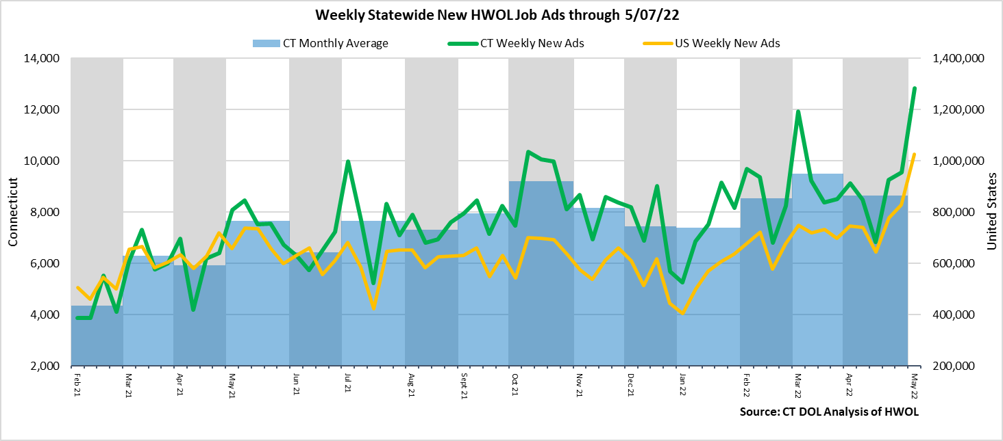
Statewide Weekly New Job Ads
Weekly New job postings was 12,838 during the week ending 5/07/22.
Connecticut Department of Labor – Research Office 200 Folly Brook Blvd. Wethersfield, CT 06109
Help Wanted Online

Slide 5
HWOL New Weekly Industry Job Ads – CT Statewide
Connecticut Department of Labor – Research Office 200 Folly Brook Blvd. Wethersfield, CT 06109
Help Wanted Online

Slide 6
Connecticut Department of Labor – Research Office 200 Folly Brook Blvd. Wethersfield, CT 06109
Help Wanted Online

Slide 7
Employers with the Most New Job Postings
Connecticut Department of Labor – Research Office 200 Folly Brook Blvd. Wethersfield, CT 06109
Help Wanted Online

Slide 8
Monthly HWOL Information
The following pages contain HWOL monthly data for April 2022. Monthly and weekly job ad information can be found here: https://www1.ctdol.state.ct.us/lmi/HWOL.asp
Connecticut Department of Labor – Research Office 200 Folly Brook Blvd. Wethersfield, CT 06109
Help Wanted Online

Slide 9
Statewide Highlights
- Total postings in Connecticut was 98,465 in April 2022, down 13.5% from March 2022. -Industry sectors with the most job postings were Health Care and Social Assistance (19,374 postings), Finance and Insurance (10,009 posting), Retail Trade (9,102 postings), and Manufacturing (8,088 postings).
-Occupations with the most postings were Registered Nurses (5,750 postings), Retail Salespersons (2,785 postings), Wholesale & Manufacturing Sales Representatives (2,144 postings), and Supervisors of Retail Sales Workers (2,036 postings).
Connecticut Department of Labor – Research Office 200 Folly Brook Blvd. Wethersfield, CT 06109
Help Wanted Online

Slide 10
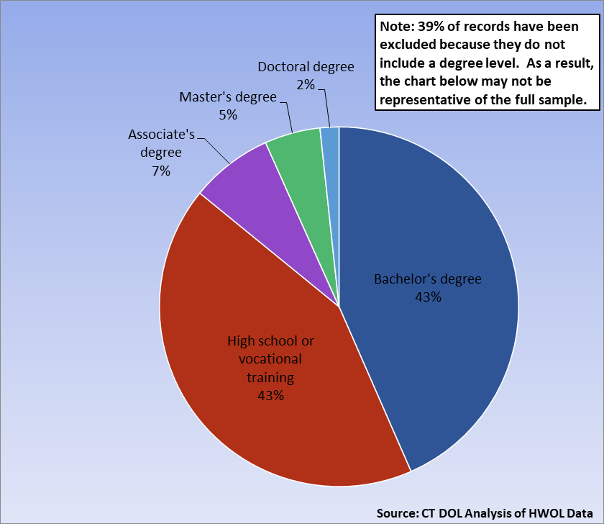
Connecticut Job Ads by Educational Requirements
Connecticut Department of Labor – Research Office 200 Folly Brook Blvd. Wethersfield, CT 06109
Help Wanted Online

Slide 11
Top Certifications in Connecticut Job Ads
Connecticut Department of Labor – Research Office 200 Folly Brook Blvd. Wethersfield, CT 06109
Help Wanted Online

Slide 12
Top Skills in Connecticut Job Ads
Connecticut Department of Labor – Research Office 200 Folly Brook Blvd. Wethersfield, CT 06109
Help Wanted Online

Slide 13
Top Skills by Industry in Connecticut Job Ads
Connecticut Department of Labor – Research Office 200 Folly Brook Blvd. Wethersfield, CT 06109
Help Wanted Online

Slide 14
Top Skills by Industry in Connecticut Job Ads (Continued)
Connecticut Department of Labor – Research Office 200 Folly Brook Blvd. Wethersfield, CT 06109
Help Wanted Online

Slide 15
Connecticut Department of Labor – Research Office 200 Folly Brook Blvd. Wethersfield, CT 06109
Help Wanted Online

Slide 16
Connecticut Employers with the Most Job Ads
Connecticut Department of Labor – Research Office 200 Folly Brook Blvd. Wethersfield, CT 06109
Help Wanted Online

Slide 17
Connecticut Occupations with the Most Job Ads
Connecticut Department of Labor – Research Office 200 Folly Brook Blvd. Wethersfield, CT 06109
Help Wanted Online

Slide 18
Connecticut Job Ads by Industry and Major Occupational Group
Connecticut Department of Labor – Research Office 200 Folly Brook Blvd. Wethersfield, CT 06109
Help Wanted Online

Slide 19
Workforce Area Data
Workforce Area Highlights
Job Ads by Industry
Job Ads by Location
Employers With The Most Job Ads
Occupations With The Most Job Ads
Connecticut Department of Labor – Research Office 200 Folly Brook Blvd. Wethersfield, CT 06109
Help Wanted Online

Slide 20
Workforce Area Highlights
Connecticut Department of Labor – Research Office 200 Folly Brook Blvd. Wethersfield, CT 06109
Help Wanted Online

Slide 21
Connecticut Department of Labor – Research Office 200 Folly Brook Blvd. Wethersfield, CT 06109
Help Wanted Online

Slide 22
Eastern Workforce Job Ads by Location
Connecticut Department of Labor – Research Office 200 Folly Brook Blvd. Wethersfield, CT 06109
Help Wanted Online

Slide 23
Eastern Workforce Employers
with the Most Job Ads
University of Connecticut
Mohegan Sun
HHM
State of Connecticut
Staples
FedEx
Walmart / Sam's
CVS Health
UnitedHealth Group
Walgreens Boots Alliance Inc
Mohegan Sun, Inc
Healthpro Heritage
Asplundh Tree Expert Company
BJ's Wholesale Club, Inc.
Hilton Hotel Corporation
Groton Public Schools
Sonalysts Incorporated
Spirol International Corporation
Greater Hartford Ymca
General Dynamics
Pfizer
Hartford Healthcare
Day Kimball Healthcare
Masonicare Corporation
Compass Group North America
Mitchell College
Norwich Public Schools
Windham Hospital
Dell
Charles River Laboratories
Mashantucket Pequot Gaming
Rogers Corporation
Generations Family Health Center
Lowe's Companies, Inc
PepsiCo Inc.
US Foods
Page Taft Compass
Community Health Resources
Connecticut Department of Labor – Research Office 200 Folly Brook Blvd. Wethersfield, CT 06109
Help Wanted Online

Slide 24
Eastern Workforce Occupations
with the Most Job Ads
Connecticut Department of Labor – Research Office 200 Folly Brook Blvd. Wethersfield, CT 06109
Help Wanted Online

Slide 25
Connecticut Department of Labor – Research Office 200 Folly Brook Blvd. Wethersfield, CT 06109
Help Wanted Online
25

Slide 26
North Central WDA Job Ads by Location
Connecticut Department of Labor – Research Office 200 Folly Brook Blvd. Wethersfield, CT 06109
Help Wanted Online

Slide 27
North Central WDA Employers
with the Most Job Ads
Raytheon
Cigna Corporation
The Hartford Financial Group
Disney
CVS Health
EverSource
Pratt & Whitney
Connectrn
Walgreens Boots Alliance Inc
Greater Hartford Ymca
Eastern Connecticut Health Network
The Home Depot Incorporated
Bank of America
PricewaterhouseCoopers
Lincoln Financial Group
Compass Group North America
Connecticut Children’s Medical Center
Genesis Healthcare Corporation
Hartford Healthcare
Capital One
UnitedHealth Group
Accenture
Travelers
State of Connecticut
Aya Healthcare
Amazon
Wheeler Clinic
KPMG
Allied Universal
Eversource Energy
University of Connecticut
East Hartford Public Schools
Stanley Black & Decker
Sysco Corporation
Pearson
Walmart / Sam's
Connecticut Department of Labor – Research Office 200 Folly Brook Blvd. Wethersfield, CT 06109
Help Wanted Online

Slide 28
North Central WDA Occupations
with the Most Job Ads
Connecticut Department of Labor – Research Office 200 Folly Brook Blvd. Wethersfield, CT 06109
Help Wanted Online

Slide 29
Connecticut Department of Labor – Research Office 200 Folly Brook Blvd. Wethersfield, CT 06109
Help Wanted Online

Slide 30
Northwest WDA Job Ads by Location
Connecticut Department of Labor – Research Office 200 Folly Brook Blvd. Wethersfield, CT 06109
Help Wanted Online

Slide 31
Northwest WDA Employers
with the Most Job Ads
Capital One
Nuvance Health
Amazon
Devereux Advanced Behavioral Health
Post University
Walgreens Boots Alliance Inc
Walmart / Sam's
State of Connecticut
United Parcel Service Incorporated
Schaeffler Group
Starbucks Coffee Company
Charter Communications
Realogy Franchise Group LLC
The Home Depot Incorporated
Community Health Center Association Of Connecticut
AutoZone Auto Parts
O'Reilly Automotive Inc
Dymax Corporation
Hartford Healthcare
Boehringer Ingelheim
Waterbury Hospital
Trinity Health
Dell
Fuelcell Energy Inc
UnitedHealth Group
CVS Health
TJX Companies, Inc.
Compass Group North America
BJ's Wholesale Club, Inc.
CDM Smith
Actalent
Applied Materials
Benchmark Senior Living
LHC Group
Stop Shop Supermarket
Genesis Healthcare Corporation
Tutored By Teachers
Connecticut Department of Labor – Research Office 200 Folly Brook Blvd. Wethersfield, CT 06109
Help Wanted Online

Slide 32
Northwest WDA Occupations
with the Most Job Ads
Connecticut Department of Labor – Research Office 200 Folly Brook Blvd. Wethersfield, CT 06109
Help Wanted Online

Slide 33
Connecticut Department of Labor – Research Office 200 Folly Brook Blvd. Wethersfield, CT 06109
Help Wanted Online

Slide 34
South Central WDA Job Ads by Location
Connecticut Department of Labor – Research Office 200 Folly Brook Blvd. Wethersfield, CT 06109
Help Wanted Online

Slide 35
South Central WDA Employers
with the Most Job Ads
Yale University
Hartford Healthcare
Capital One
Medtronic
Alexion Pharmaceuticals
Avangrid
State of Connecticut
UnitedHealth Group
Quinnipiac University
Walmart / Sam's
Gaylord Hospital
Raytheon
Wesleyan University
A R Mazzotta Employment
Southern Connecticut State University
AutoZone Auto Parts
Genesis Healthcare Corporation
Lowe's Companies, Inc
Ametek Incorporated
Yale-New Haven Health System
Anthem Blue Cross
Amazon
University of New Haven
Masonicare Corporation
Walgreens Boots Alliance Inc
Middlesex Health System Incorporated
Department of Veterans Affairs
Aya Healthcare
Michaels Arts and Crafts
Marrakech
CVS Health
Page Taft Compass
Taco Bell
The Home Depot Incorporated
Arrow Electronics
O'Reilly Automotive Inc
Starbucks Coffee Company
Allied Universal
Connecticut Department of Labor – Research Office 200 Folly Brook Blvd. Wethersfield, CT 06109
Help Wanted Online

Slide 36
South Central WDA Occupations
with the Most Job Ads
Connecticut Department of Labor – Research Office 200 Folly Brook Blvd. Wethersfield, CT 06109
Help Wanted Online

Slide 37
Connecticut Department of Labor – Research Office 200 Folly Brook Blvd. Wethersfield, CT 06109
Help Wanted Online

Slide 38
Southwest WDA Job Ads by Location
Connecticut Department of Labor – Research Office 200 Folly Brook Blvd. Wethersfield, CT 06109
Help Wanted Online

Slide 39
Southwest WDA Employers
with the Most Job Ads
Charter Communications
Yale-New Haven Health System
Lockheed Martin Corporation
ASML Holding N V
Norwalk Public School District
Hartford Healthcare
Synchrony
Pitney Bowes
Griffin Health Services Corporation
Walgreens Boots Alliance Inc
Aya Healthcare
Allied Universal
Sacred Heart University
The Home Depot Incorporated
NBC
Town Greenwich
HEI Hotels & Resorts
Apple Inc.
Starbucks Coffee Company
Humana
PricewaterhouseCoopers
Capital One
KPMG
Stamford Hospital
Compass Group North America
Vmware Incorporated
Amazon
Greenwich Public Schools
Whole Foods Market, Inc.
Coopersurgical
Synchrony Financial
Sunrise Senior Living, Inc.
Gartner Incorporated
Deloitte
Norwalk Public Schools
Fairfield University
CDM Smith
World Wrestling Entertainment
Connecticut Department of Labor – Research Office 200 Folly Brook Blvd. Wethersfield, CT 06109
Help Wanted Online

Slide 40
Southwest WDA Occupations
with the Most Job Ads
Connecticut Department of Labor – Research Office 200 Folly Brook Blvd. Wethersfield, CT 06109
Help Wanted Online

Slide 41
All advertisement data used in this publication is from the Conference Board’s Help Wanted Online data series.
For more information or data requests, contact Matthew Krzyzek in the Office of Research at the Department of Labor.
Matthew.Krzyzek@ct.gov
For more Connecticut Labor Market Information visit:
www.ctdol.state.ct.us/lmi
https://www.facebook.com/ctlmi
Twitter: @DOL_Research
Connecticut Department of Labor – Research Office 200 Folly Brook Blvd. Wethersfield, CT 06109
Help Wanted Online

